Slide 1


ANZ Transactions Dataset

Slide 2
TOC
About The Data
Gender Analysis
Age Analysis
Location Analysis
Transactions Analysis

Slide 3
About The Data
The dataset has about 12043 rows and 23 columns.
There were a lot of missing data in certain columns , those columns were either treated or dropped.
There were several columns with a lot of unique values.
The dataset contains the transactions made by 100 customers for the month of August, September and October.

Slide 4
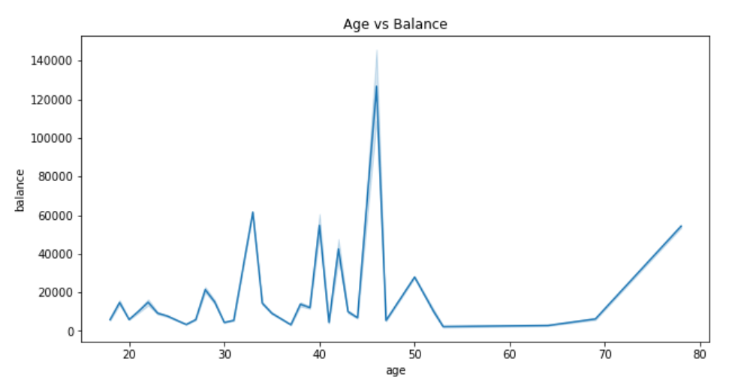
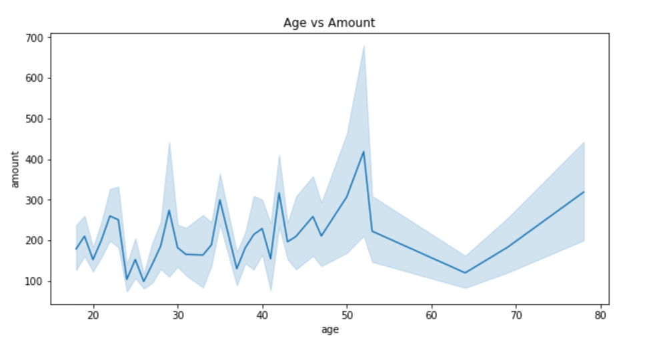
Age Analysis
The age group from 40-50 have higher balance.
Age group between 45 - 55 has transacted more amount above 400 (in dollars).
Age group between 24-28 has transacted least amount approx 100 or above.

Slide 5
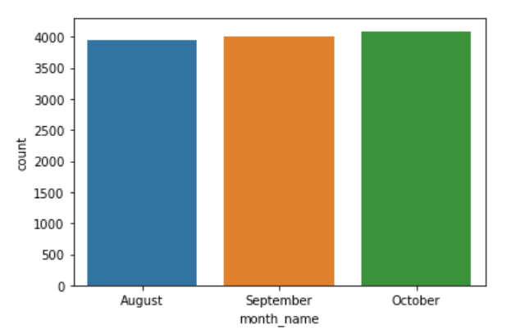
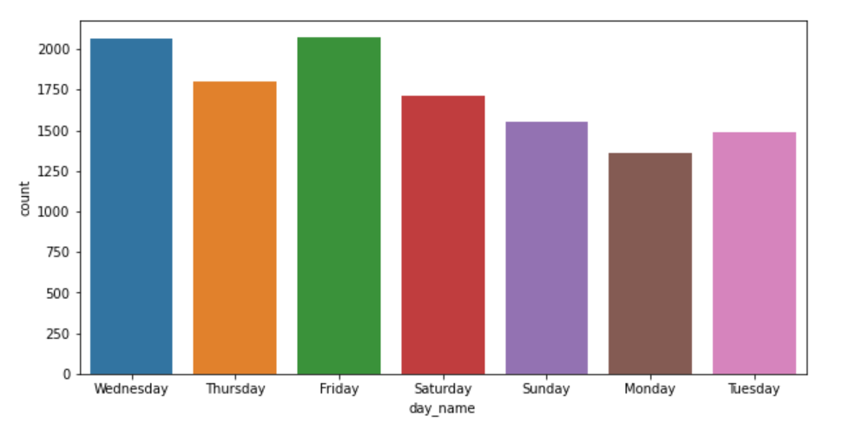
Transactions Analysis
Transactions for each are approximately the same.
Transactions for Wednesday & Friday are higher.

Slide 6
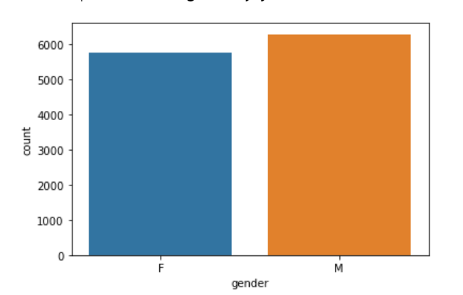
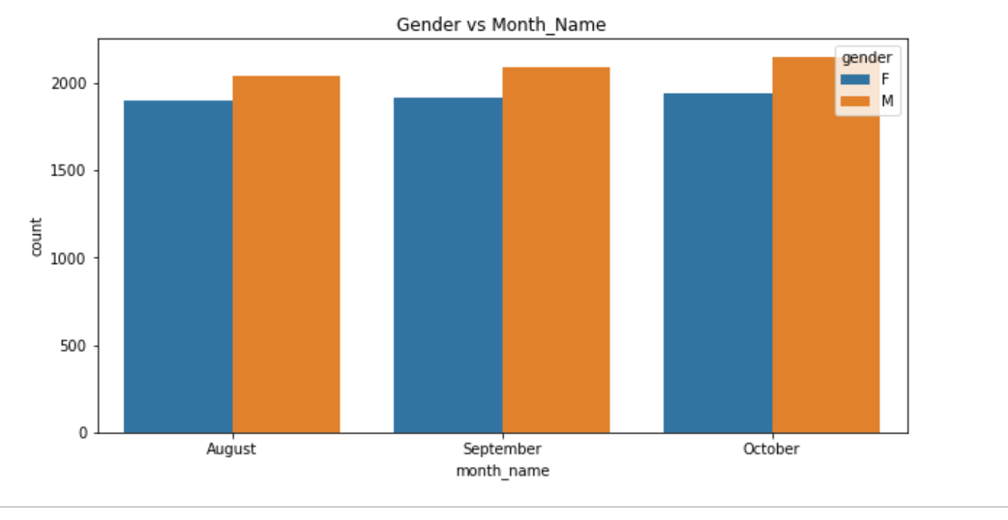
Gender Analysis
Transactions from men and women were about same, although male transactions were somewhat slightly greater.
Male transactions were greater in all months.

Slide 7
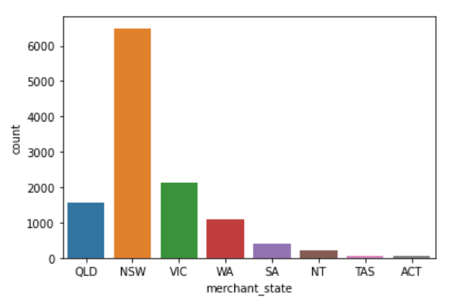
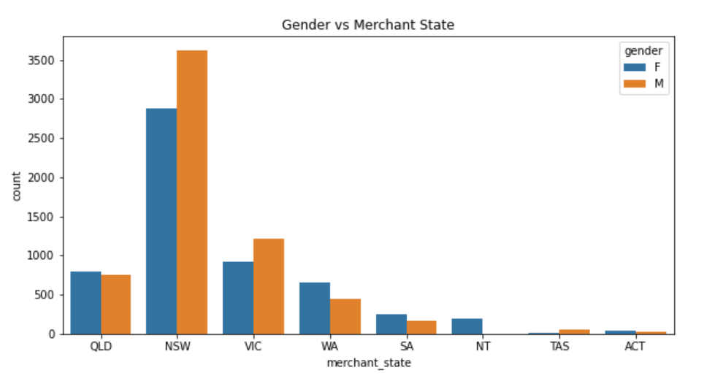
Location Analysis
The highest transactions are from NSW .
Transaction are higher from males residing in NSW.

Slide 8
Thank you!

